Slide 1
PRESENTATION TEMPLATE – HOW TO USE THIS SLIDE IS TO BE DELETED ONCE YOUR PRESENTATION IS READY
This template is for you! Edit the text, delete what you don’t need, add what you want.
Add your organization’s logo
Remove anything you don’t want to include
Add or edit content so that it suits your needs
The notes at the bottom of the slide contain some key messages you could say, suggestions for some activities and ideas you can take or leave. Please feel free to edit them!
As you prepare for your presentation, consider looking at your organization’s strategic plan or other guiding documents to find relevant connections to social prescribing work; this will help you make connection with your team.
Consider adding engaging moments to your presentation if that suits your audience OR consider pairing down the slides to keep the presentation short if that’s the best for your team.

Slide 2
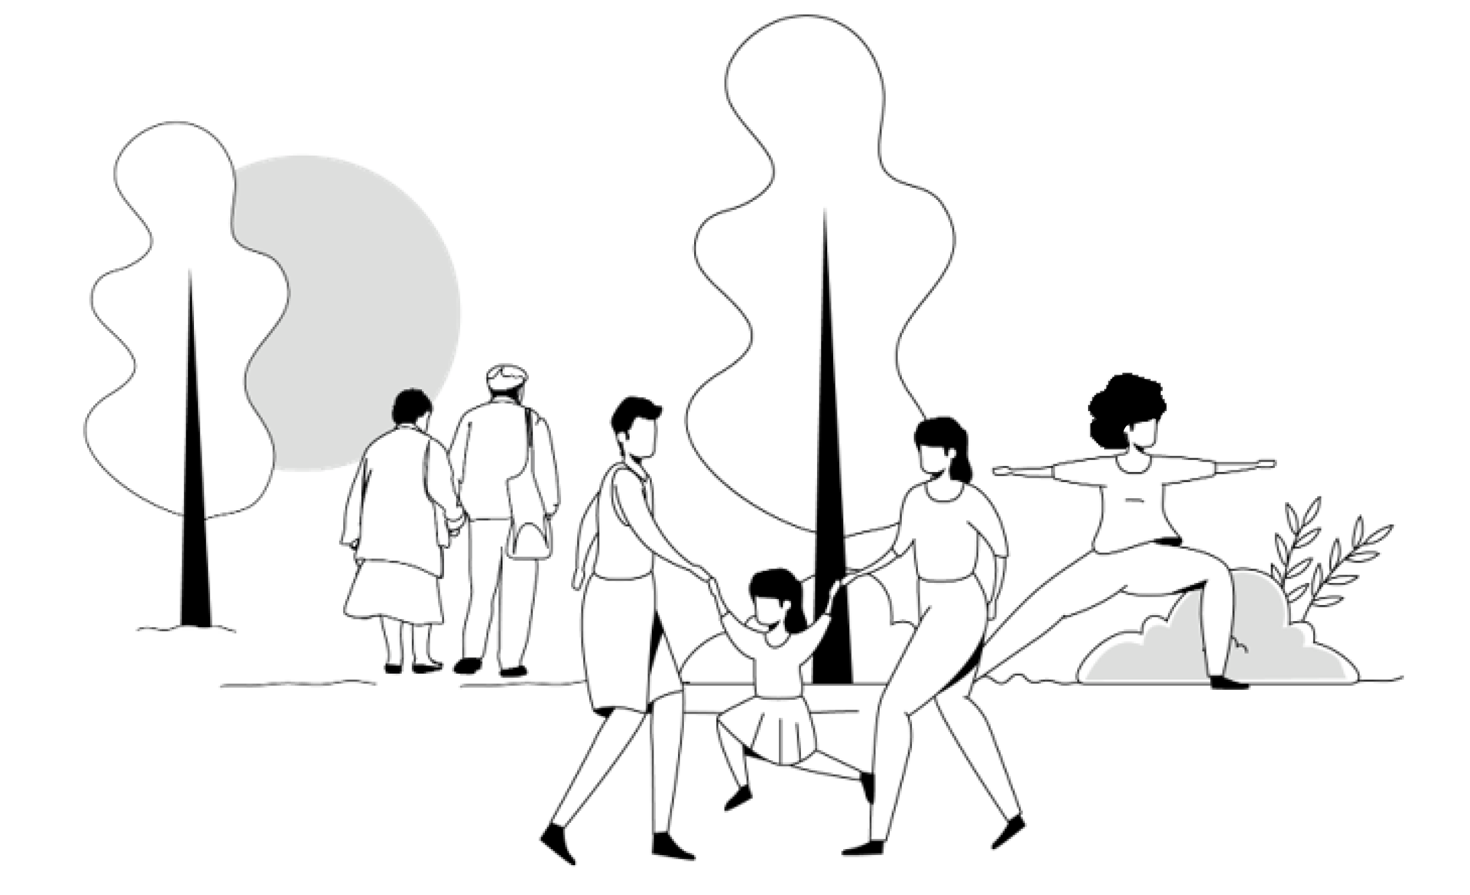
Social Prescribing at [name of your organization]

Slide 3

WHAT IS SOCIAL PRESCRIBING?
Social prescribing is connecting a client to a non-clinical program or service that supports their health and wellbeing.
Notes:
Key messages: Social prescribing can look different for each community depending on resources and supports.

Slide 4
WHAT IS SOCIAL PRESCRIBING?
Or put another way:
An intentional, structured way of connecting people with a range of local, non-clinical services, to address the determinants of health and wellbeing for your clients and community members.
Notes:
Key messages: Social prescribing can look different for each community depending on resources and supports.

Slide 5

WHAT IS SOCIAL PRESCRIBING?
But social prescribing isn’t new!
That’s true!
Social prescribing may be a new name for something we are already doing
Building a more formal social prescribing pathway:
helps make it intentional
helps streamline the process of connecting clients to resources
documents the work
provides data for quality improvement
provides a strong case for increased funding and resources
Notes:
Delete if irrelevant to your situation

Slide 6

WHAT IS SOCIAL PRESCRIBING?
Instead of asking:
We are asking:
What is the matter with you?
What matters to you?

Slide 7

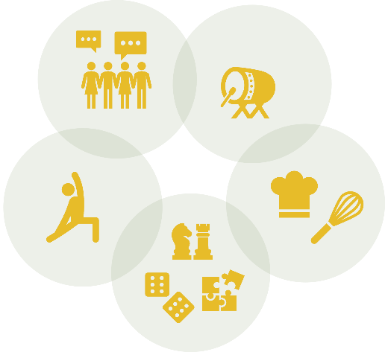



SOCIAL PRESCRIBING COMPONENTS
The EMR is used throughout the process to document the client‘s referral pathway, client follow-ups, and provide data to inform program planning and improvement.
DATA TRACKING
CLIENT
PROVIDER
NAVIGATOR/CONNECTOR
A client is identified as having needs other than clinical, during a visit.
Healthcare provider identifies non-medical issues and makes a social prescription referral.
A navigator connects with the client. Together they identify the client’s interests, needs and barriers to participation. The navigator finds appropriate community programs and services.
CONNECTED CLIENT
The client is then connected to programs and community resources, and the navigator follows up with the client.
Notes:
Typically, a SP pathway looks like this:
A client is identified as having needs other than clinical, during a visit with a provider.
The provider refers the client to a navigator -- or connector -- via a formal referral in the EMR.
The navigator then connects with the client. Together, they identify the client’s interests, needs and barriers to participation.
The navigator then connects them with the appropriate community resources and programs. The navigator follows up with the client.
All along this process, the EMR is used to document the client’s referral pathway, document client follow up, and provide data to inform future program planning and improvement.

Slide 8
SOCIAL PRESCRIBING PROCESS STEPS: EXAMPLE
ENTRY
CONSULTATION & CONNECTION
FOLLOW UP
Document
Document
Document
Is client interested in SP?
Client connected to services and programs (including wraparound supports)
Entry / Client Identification
Client consultation
Check in / Make changes if necessary
Follow Up / Impact assessment
Yes
Yes
Future check in
Is client interested in SP?
Exit
More programs provided
OR Exit
No
No

Slide 9











IMPACT: CLIENTS CONNECTED TO COMMUNITY
CLIENT

Slide 10







SP WORKS IN MANY SETTINGS
Lakeshore Community Nurse Practitioner-Led Clinic – Located in a smalltown, NPs are the lead providers of primary health care
Centre de santé communautaire du Témiskaming – Serves a large Northern area. Model uses no link worker
Regent Park CHC – Serves a urban population, low-barrier model of services including ground floor Consumption & Treatment Services & Harm Reduction space
Somerset West CHC – Black-focused social prescribing, large urban setting, on-site community programs and many resources available
Harrow Health Centre Family Health Team –Small, rural, farming community
Mino M’shki-ki Indigenous Health Team – Providing culturally meaningful services and programs
1
2
3
6
4
2
5
4
3
6
1
5
Notes:
Key message: Social prescribing can look different for each community depending on resources and supports. The type of centre can vary from a nurse practitioner-led clinic (NPLC), to a family health team, a community health center, the size and composition of the team can look very different with a link worker (or navigator) or none, the location can be very rural or very urban, etc.

Slide 11



THE IMPACT OF SOCIAL PRESCRIBING
The impacts of social prescribing from programs in the UK (2017–2019) demonstrate that from social prescribing, the healthcare system saw a:
14%
40%
20.8%
Decrease in emergency room visits
Decrease in general
physician visits
Reduction in costs to the health system

Slide 12



THE IMPACT OF SOCIAL PRESCRIBING
At the end of the Alliance for Healthier Communities social prescribing research pilot:
29%
36%
41%
More clients scored their mental health as either excellent, very good, or good after participating in SP
More clients scored their sense of community belonging as either excellent, very good or good after participating in SP
Of providers reported observing a decrease in the number of repeat visits among clients who participated in SP

Slide 13


POSITIVE IMPACTS FOR CLIENTS AND PROVIDERS
The ability to offer social prescriptions has decreased my visits. It has alleviated stressors for my clients. I have seen positive turn-arounds in clients’ overall mood. Social prescribing also helps ease the strain on our health system, while giving clients a sense of community and belonging that COVID-19 eroded.
— Terry, Clinician
Lakeshore Community NPLC

Slide 14

POSITIVE IMPACTS FOR CLIENTS AND PROVIDERS
For 6 months I resisted asking questions [about loneliness and wellbeing] to the client, thinking it would take too long. When I finally did it, it took no more than a minute!
— Nurse
A nurse meeting with a colleague

Slide 15

POSITIVE IMPACTS FOR CLIENTS AND PROVIDERS
I appreciated the kindness of people and realizing that there are nice people in this world. It’s just a matter of finding them. Another lady I know, she’s in her eighties, and she lost her husband about a year ago. She is very lonely. That’s why I encouraged her to go to Life After Fifty. Like me, she needed the initial push to go, but I think once she goes, she’ll enjoy it.
— Linda, Links2Wellbeing Project Participant
Seaway Valley CHC

Slide 16
PROMPTS FOR REFLECTION
“What are some non-clinical programs and services in our community that could support our clients?”
“How could social prescribing advance equity work at our centre?”
“How could social prescribing improve our workflow as a team?”

Slide 17
COMMON CRITIQUES
I don't like that it's called a “prescription”.
For some communities, the term “social prescribing” doesn't quite fit and that’s OK! You might like the language of social connection better. Some Indigenous-led centres use “rekindling relationships”. Many centres fit this work under health promotion.
You can use language that fits you and your community.
Notes:
Key messages: Social prescribing can look different for each community depending on resources and supports.

Slide 18
COMMON CRITIQUES
It works in other centres but it won’t work in ours.
Social prescribing looks different at every organization. There are community health centres, nurse/practitioner-led clinics, family health teams, and hospitals that all implement social prescribing.
It works in all kinds of communities and all kinds of organizations. You can tailor your social prescribing process to meet your context.
Notes:
Social Prescribing is specific to each context and can work in a variety of settings

Slide 19
COMMON CRITIQUES
You need to have a link worker, and we don't have one.
Many organizations have built social prescribing pathways that don't include a link worker:
Some providers directly make the referral using the EMR
Some providers refer the client to an inter-professional team that meets weekly to review referrals together
Notes:
Build the social prescribing pathway that works for you and your context

Slide 20


For more information, including resources and research related to social prescribing in Ontario, visit: www.allianceon.org/Social-Prescribing

Slide 21
Next steps: [Add next steps for your team following this training]

